Slide 1
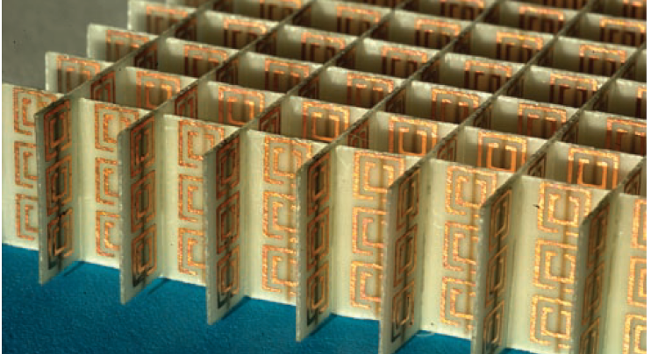

Ordinal Logistic Regression
2021 | ANDRÉ NÜßLEIN, DOLEV ILLOUZ
Image adapted from Boltasseva, A., & Shalaev, V. M. (2008). “Fabrication of optical negative-index metamaterials.” Metamaterials, 2(1).

Slide 2
Modelling beta-carotene plasma levels
Beta-Carotene
(Talk about the importance of it and the parameters used to model it)
Ordinal Logistic Models
What is ordinal and how do we compute probabilities
Multinomial Logistic Models
How is multinomial different.
Image adapted from Engheta, N. and Ziolkowski, R., 2005. Electromagnetic metamaterials. Hoboken, N.J.: Wiley.
Notes:
Fundamentally, electromagnetic waves interact with the bulk material, hence if the bulk is a composite material, the effective permitivitty and effective permeability are the average of the constituents.
In nature, materials with a Negative permitivitty (epsilon) in the IR/Visible range are found in nature in metals such as silver and gold, and negative permeabilities (mu) are found in gyrotropic magnetic materials. This would indicate that it is possible to construct a material that would have both negative permeability and permittivity. However, we know that both of these parameters are a function of the interacting EM waves’ frequency.
Thus, the technical issue lies in creating metamaterials with both a negative permeability and permitivitty in a certain frequency band. To do so, we need to turn to the mathematics of metamaterials. Based on the Lorentz and Drude models, the electric and magnetic susceptibility can be negative just above the plasma frequency. (N)

Slide 3
Ordinal Models Tested
AIC
Forwards
Backwards
BIC
Forwards
Backwards
Manual Testing
Notes:
The most general second-order model that has been introduced for metamaterial studies is the two-time-derivative Lorentz metamaterial.
Where gamma is the width of the resonance, The terms xi_a, xi_b, and xi_gamma represent, respectively, the coupling of the electric (magnetic) field and its first- and second-time derivatives to the local charge motion.
w0 and wp are the resonant and plasma frequency, respectively, that are determined by the material used, the structure's geometry, and the interacting field. $ω_{p}^{2} = 4π(\frac{ne^{2}}{m^{∗}})$
The topmost expression satisfies the kramers-kroning relation and causality for x_gamma less than -1. In the limit that w goes to 0 x_e goes x_a and in the limit that w goes to infinity x_E goes to x_gamma. For x_gamma between 0 and -1 the resulting permittivity is between 0 and 1, meaning that the group velocity exceeds the speed of light in that medium (Engheta & Ziolkowski); this does not violate the theory of special relativity because the group velocity is the velocity of the peak of the localized wave packet which does not carry information. (Luo, Hailu & Hu, Wei & Shu, Weixing & Li, Fei & Ren, Zhongzhou. (2006). Superluminal group velocity in an anisotropic metamaterial. EPL (Europhysics Letters). 74. 10.1209/epl/i2006-10046-4. ) While some papers claim and report that superluminal propagation occurs in fabricated structures, there are other papers, Luan & Wu 2018, that claim such a phenomenon is impossible.

Slide 4
Final Ordinal Model
Parameters
Plots*
Notes:
The most general second-order model that has been introduced for metamaterial studies is the two-time-derivative Lorentz metamaterial.
Where gamma is the width of the resonance, The terms xi_a, xi_b, and xi_gamma represent, respectively, the coupling of the electric (magnetic) field and its first- and second-time derivatives to the local charge motion.
w0 and wp are the resonant and plasma frequency, respectively, that are determined by the material used, the structure's geometry, and the interacting field. $ω_{p}^{2} = 4π(\frac{ne^{2}}{m^{∗}})$
The topmost expression satisfies the kramers-kroning relation and causality for x_gamma less than -1. In the limit that w goes to 0 x_e goes x_a and in the limit that w goes to infinity x_E goes to x_gamma. For x_gamma between 0 and -1 the resulting permittivity is between 0 and 1, meaning that the group velocity exceeds the speed of light in that medium (Engheta & Ziolkowski); this does not violate the theory of special relativity because the group velocity is the velocity of the peak of the localized wave packet which does not carry information. (Luo, Hailu & Hu, Wei & Shu, Weixing & Li, Fei & Ren, Zhongzhou. (2006). Superluminal group velocity in an anisotropic metamaterial. EPL (Europhysics Letters). 74. 10.1209/epl/i2006-10046-4. ) While some papers claim and report that superluminal propagation occurs in fabricated structures, there are other papers, Luan & Wu 2018, that claim such a phenomenon is impossible.

Slide 5
Final Ordinal Model
Confusion Matrix +Sens, etc.
Notes:
The most general second-order model that has been introduced for metamaterial studies is the two-time-derivative Lorentz metamaterial.
Where gamma is the width of the resonance, The terms xi_a, xi_b, and xi_gamma represent, respectively, the coupling of the electric (magnetic) field and its first- and second-time derivatives to the local charge motion.
w0 and wp are the resonant and plasma frequency, respectively, that are determined by the material used, the structure's geometry, and the interacting field. $ω_{p}^{2} = 4π(\frac{ne^{2}}{m^{∗}})$
The topmost expression satisfies the kramers-kroning relation and causality for x_gamma less than -1. In the limit that w goes to 0 x_e goes x_a and in the limit that w goes to infinity x_E goes to x_gamma. For x_gamma between 0 and -1 the resulting permittivity is between 0 and 1, meaning that the group velocity exceeds the speed of light in that medium (Engheta & Ziolkowski); this does not violate the theory of special relativity because the group velocity is the velocity of the peak of the localized wave packet which does not carry information. (Luo, Hailu & Hu, Wei & Shu, Weixing & Li, Fei & Ren, Zhongzhou. (2006). Superluminal group velocity in an anisotropic metamaterial. EPL (Europhysics Letters). 74. 10.1209/epl/i2006-10046-4. ) While some papers claim and report that superluminal propagation occurs in fabricated structures, there are other papers, Luan & Wu 2018, that claim such a phenomenon is impossible.

Slide 6
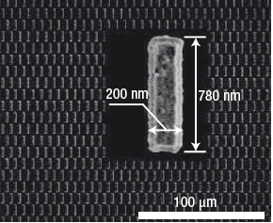
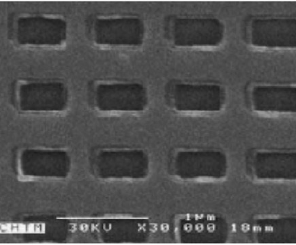
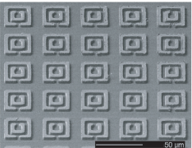
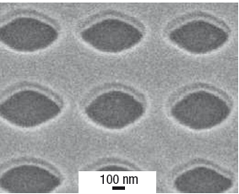
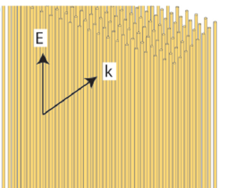
Common Structures
Images adapted from Boltasseva, A., 2008. Shalaev, V. M., 2006. and Padilla, W. J., 2006.
Notes:
Metamaterials' behaviors are a consequence of the meta-"atoms" or the "unit-cells" formed by periodic inclusions.
Some common structures are Paired Nanorods (Top Left), Fishnets (Top Center), Split Ring Resonators (Top Right), Elliptic Voids (Bottom Left), Wire Meshes (Bottom Right).
Each of these structures provides alternative benefits compared to the others, but each of these 2D structures can be repeated and stacked atop one another to generate 3D metamaterials
*In a wire MM, n and m* are related to the geometry of the lattice rather than the fundamental charge carriers, giving MMs much greater flexibility than conventional materials. Because the effective density can be reduced substantially by making the wires thin, which has the added effect of increasing the effective mass of the charge carriers, the effective plasma frequency can be reduced by many orders of magnitude.*
*Fishnets provide the highest known FOM and have a theoretical maximum of ~200*
*An a.c. electric field parallel to both rods induces parallel currents in both rods. The magnetic fi eld, which is oriented perpendicular to the plane of the rods, causes antiparallel currents in the two rods. These antiparallel currents cause the magnetic response of the system. The magnetic response will be dia- or paramagnetic depending on whether the wavelength of the incoming magnetic field is shorter or longer than the magnetic resonance of the coupled rods.*
*In the fishnet structure, the pairs of broader metal strips provide negative permeability by means of the asymmetric currents*
*Fishnets adapted from Boltasseva, A., & Shalaev, V. M. (2008). “Fabrication of optical negative-index metamaterials.” Metamaterials, 2(1).*
*Paired wires and voids adapted from Shalaev, V. M. (2007). Optical negative-index metamaterials. Nature photonics, 1(1), 41-48.”
*SRR’s and Wires adapted from Padilla, W. J., Basov, D. N., & Smith, D. R. (2006). Negative refractive index metamaterials. Materials today, 9(7-8), 28-35.

Slide 7
Multinomial Models Tested
AIC
Forwards
Backwards
BIC
Forwards
Backwards
Manual Testing
Notes:
There are many methods and techniques at the disposal of nanoscience engineers to fabricate the structures mentioned earlier.
Electron-beam lithography being the first choice for fabricating small-area metamaterials (∼100\mu m×100\mu m). Larger areas require longer writing times, which increases the operational cost making it unfeasible for large-scale manufacturing processes. Focused-ion beam milling techniques suffer from the same issue as EBL and are limited to the useable materials. However, it is a much faster process.
Fabricating onto larger-areas (~cm^2) can be done through the use of interference lithography, which has the potential to be combined with self-assembly techniques, thereby decreasing the possible feature size. Similarly, nanoimprint lithography can be used to leverage the benefits of EBL's accuracy at the macroscale, as the mask is constructed once. Thus, it is not suited to prototyping/proof-of-concept designs.
Epitaxial & lithographic approaches of making stacked metamaterials still have significant limitations in the lift-off procedure and alignment requirements. Alternatively, stacked metamaterials could be fabricated using deep anisotropic etching of a pre-fabricated multilayer stack. However, challenges related to the dry etching procedure of the metal-dielectric stacks have prevented this from being pursued.
Finally, the two-photon photopolymerization techniques offer sub-diffraction resolution (down to 100 nm) due to a nonlinear multiphoton process and can write onto multiple locations simultaneously. In combination with thin metal deposition techniques, the resulting structures can be completely arbitrary in shape. However, this approach needs further advances and developments for creating thin, uniform, and smooth layers of different materials on a TPP-fabricated polymer matrix.

Slide 8
Final Multinomial Model
Parameters
Plots*
Notes:
The most general second-order model that has been introduced for metamaterial studies is the two-time-derivative Lorentz metamaterial.
Where gamma is the width of the resonance, The terms xi_a, xi_b, and xi_gamma represent, respectively, the coupling of the electric (magnetic) field and its first- and second-time derivatives to the local charge motion.
w0 and wp are the resonant and plasma frequency, respectively, that are determined by the material used, the structure's geometry, and the interacting field. $ω_{p}^{2} = 4π(\frac{ne^{2}}{m^{∗}})$
The topmost expression satisfies the kramers-kroning relation and causality for x_gamma less than -1. In the limit that w goes to 0 x_e goes x_a and in the limit that w goes to infinity x_E goes to x_gamma. For x_gamma between 0 and -1 the resulting permittivity is between 0 and 1, meaning that the group velocity exceeds the speed of light in that medium (Engheta & Ziolkowski); this does not violate the theory of special relativity because the group velocity is the velocity of the peak of the localized wave packet which does not carry information. (Luo, Hailu & Hu, Wei & Shu, Weixing & Li, Fei & Ren, Zhongzhou. (2006). Superluminal group velocity in an anisotropic metamaterial. EPL (Europhysics Letters). 74. 10.1209/epl/i2006-10046-4. ) While some papers claim and report that superluminal propagation occurs in fabricated structures, there are other papers, Luan & Wu 2018, that claim such a phenomenon is impossible.

Slide 9
Final Multinomial Model
Confusion Matrix +Sensitivity, etc.
Notes:
The most general second-order model that has been introduced for metamaterial studies is the two-time-derivative Lorentz metamaterial.
Where gamma is the width of the resonance, The terms xi_a, xi_b, and xi_gamma represent, respectively, the coupling of the electric (magnetic) field and its first- and second-time derivatives to the local charge motion.
w0 and wp are the resonant and plasma frequency, respectively, that are determined by the material used, the structure's geometry, and the interacting field. $ω_{p}^{2} = 4π(\frac{ne^{2}}{m^{∗}})$
The topmost expression satisfies the kramers-kroning relation and causality for x_gamma less than -1. In the limit that w goes to 0 x_e goes x_a and in the limit that w goes to infinity x_E goes to x_gamma. For x_gamma between 0 and -1 the resulting permittivity is between 0 and 1, meaning that the group velocity exceeds the speed of light in that medium (Engheta & Ziolkowski); this does not violate the theory of special relativity because the group velocity is the velocity of the peak of the localized wave packet which does not carry information. (Luo, Hailu & Hu, Wei & Shu, Weixing & Li, Fei & Ren, Zhongzhou. (2006). Superluminal group velocity in an anisotropic metamaterial. EPL (Europhysics Letters). 74. 10.1209/epl/i2006-10046-4. ) While some papers claim and report that superluminal propagation occurs in fabricated structures, there are other papers, Luan & Wu 2018, that claim such a phenomenon is impossible.

Slide 10
Common Structures
Images adapted from Boltasseva, A., 2008. Shalaev, V. M., 2006. and Padilla, W. J., 2006.
Notes:
Metamaterials' behaviors are a consequence of the meta-"atoms" or the "unit-cells" formed by periodic inclusions.
Some common structures are Paired Nanorods (Top Left), Fishnets (Top Center), Split Ring Resonators (Top Right), Elliptic Voids (Bottom Left), Wire Meshes (Bottom Right).
Each of these structures provides alternative benefits compared to the others, but each of these 2D structures can be repeated and stacked atop one another to generate 3D metamaterials
*In a wire MM, n and m* are related to the geometry of the lattice rather than the fundamental charge carriers, giving MMs much greater flexibility than conventional materials. Because the effective density can be reduced substantially by making the wires thin, which has the added effect of increasing the effective mass of the charge carriers, the effective plasma frequency can be reduced by many orders of magnitude.*
*Fishnets provide the highest known FOM and have a theoretical maximum of ~200*
*An a.c. electric field parallel to both rods induces parallel currents in both rods. The magnetic fi eld, which is oriented perpendicular to the plane of the rods, causes antiparallel currents in the two rods. These antiparallel currents cause the magnetic response of the system. The magnetic response will be dia- or paramagnetic depending on whether the wavelength of the incoming magnetic field is shorter or longer than the magnetic resonance of the coupled rods.*
*In the fishnet structure, the pairs of broader metal strips provide negative permeability by means of the asymmetric currents*
*Fishnets adapted from Boltasseva, A., & Shalaev, V. M. (2008). “Fabrication of optical negative-index metamaterials.” Metamaterials, 2(1).*
*Paired wires and voids adapted from Shalaev, V. M. (2007). Optical negative-index metamaterials. Nature photonics, 1(1), 41-48.”
*SRR’s and Wires adapted from Padilla, W. J., Basov, D. N., & Smith, D. R. (2006). Negative refractive index metamaterials. Materials today, 9(7-8), 28-35.

Slide 11
Comparison of Multinomial & Ordinal Models
ROC, Sensitivity, Accuracy, & precision.
Notes:
There are difficulties in achieving very large or very small values of the permeability and permittivity which is necessary to achieve perfect claoking.. Furthermore, broadband cloaking requires superluminal group velocities in the medium which is, as mentioned, a contentious subject; other caveats exist for which cloaking may be achieved, however, these are unrelated to metamaterials.
Regardless of the desired application, these metamaterials are of interest only if the propagating waves are usable. The figure of merit give a standardized score for attenuation occurring within the medium (refraction real part, attenuation imaginary).
Finally, there exist limitations to all metal-dielectric based metamaterials, as macroscopically circulating currents are needed in order to exhibit an effective magnetic response. At optical and ultraviolet wavelengths, metals become transparent to light and thus loose their metallic ‘free-electron’-like properties, including their conductivity. Furthermore, since wavelength and frequency scale inversely, the cell-size-to-wavelength parameter, a/λ0 << 1, is no longer satisfied and we are thus not in the effective material regime. Both above limitations seem to indicate that EM-MMs will begin to fail for increasing frequencies somewhere around the optical range.

Slide 12
Thank you for your attention.

